Slide 1
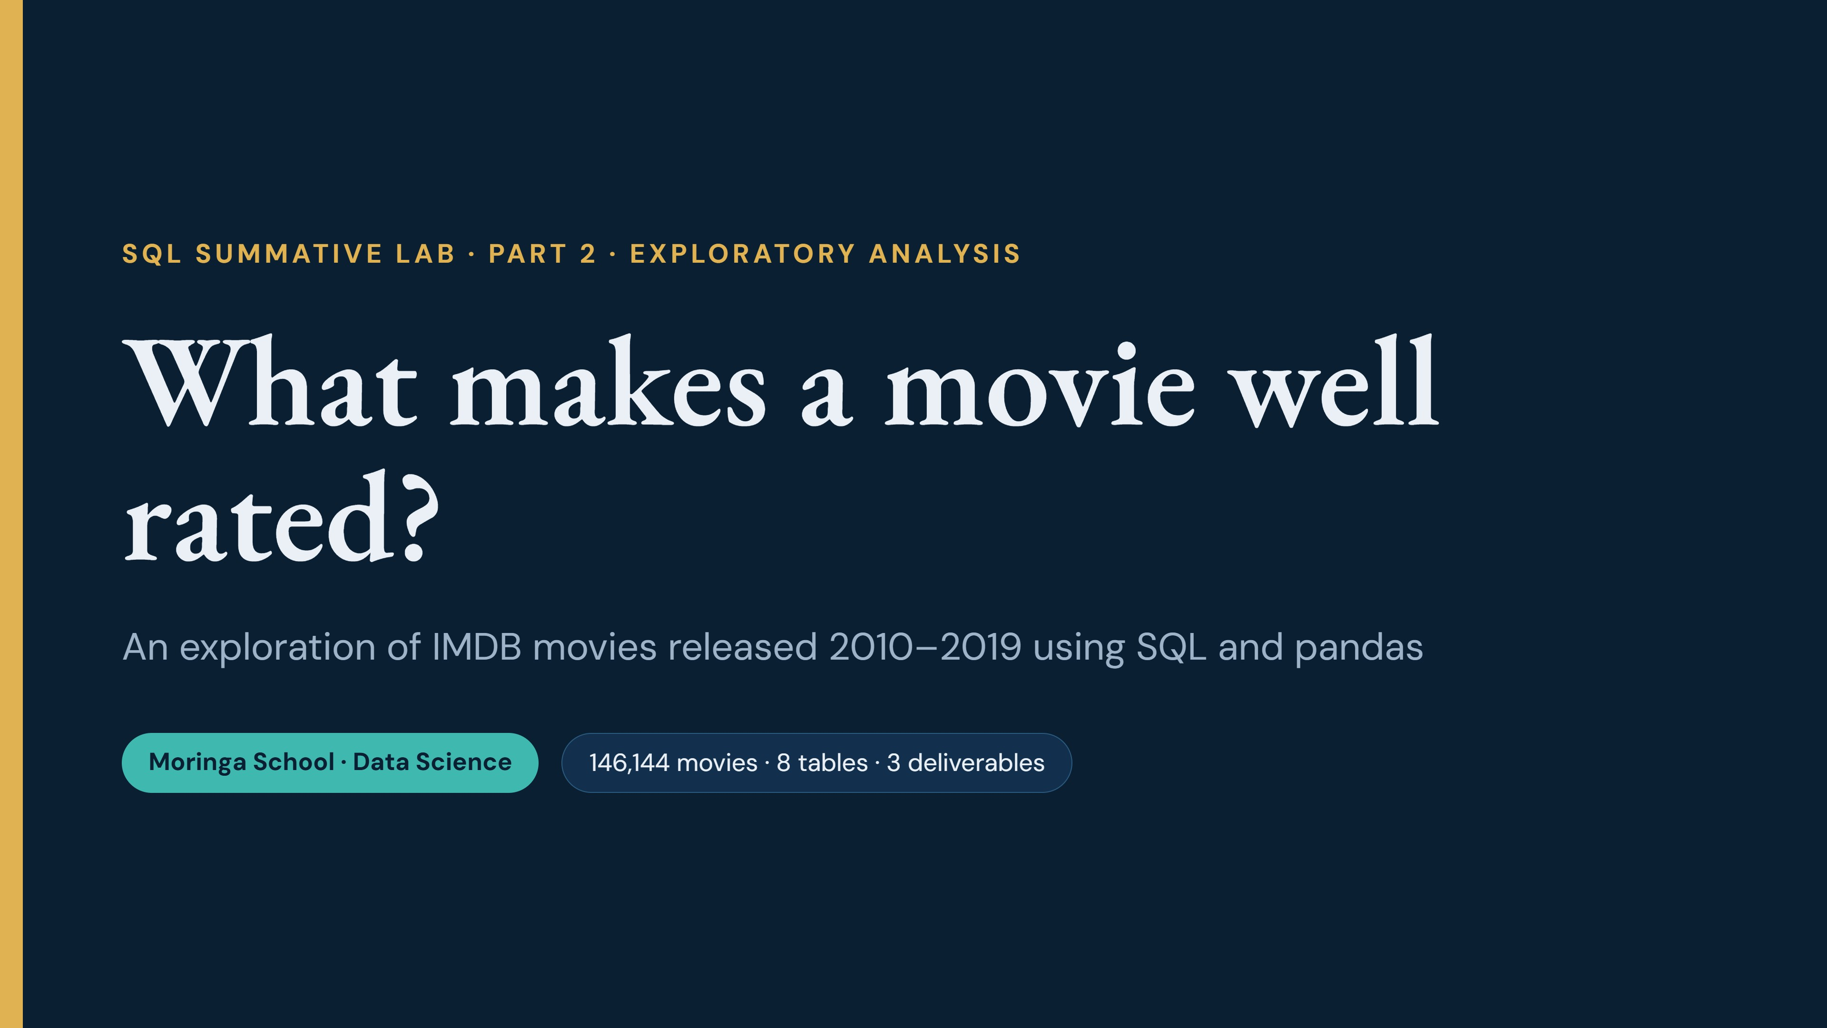
Notes:
Introduce the project. We explored the IMDB movie database, limited to movies released between 2010 and 2019, using SQL together with pandas. The next slides cover our initial findings, one business question supported by a chart, and the data cleaning tasks we would address next.

Slide 2
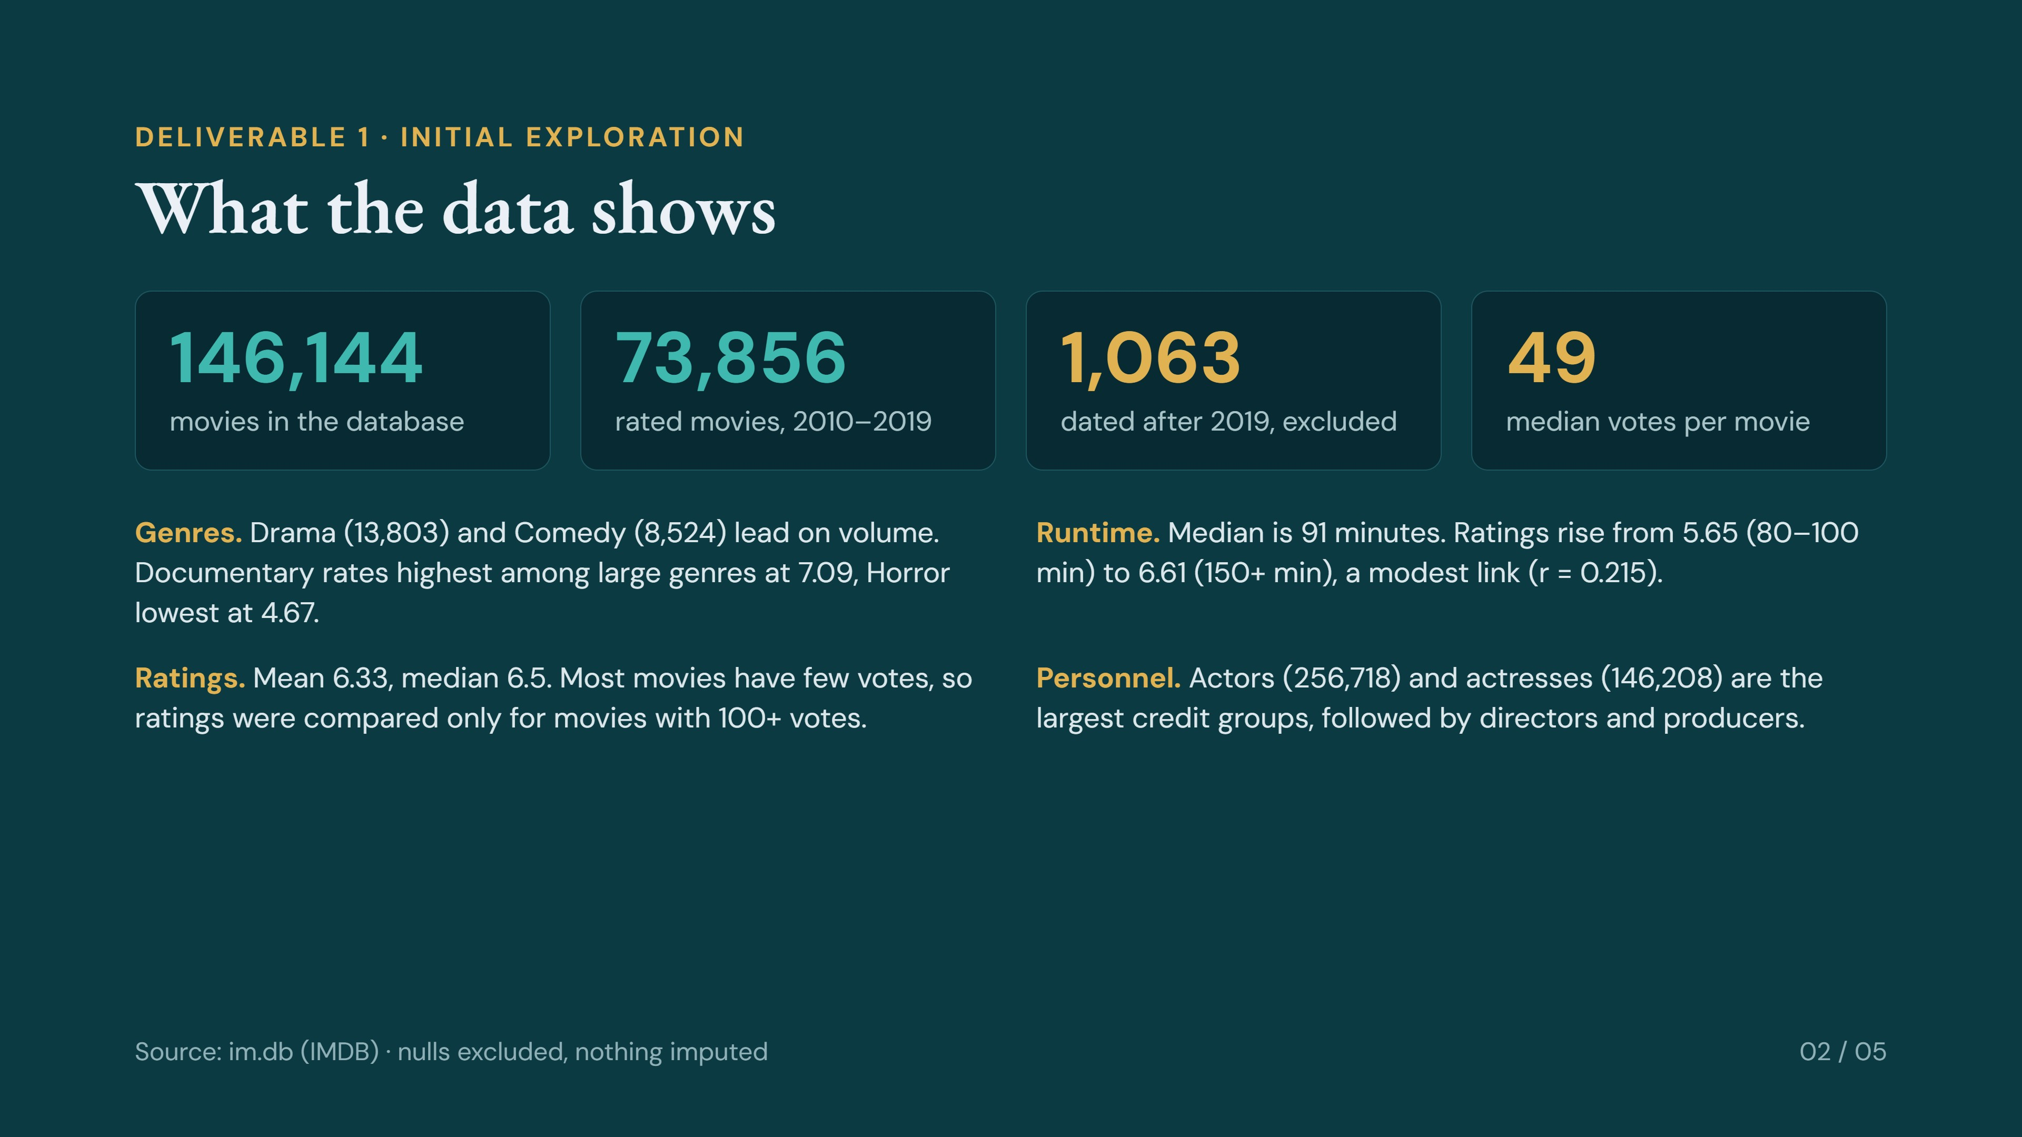
Notes:
Deliverable one. The database holds 146,144 movies. We limited the analysis to 2010 to 2019, which excludes 1,063 movies dated after 2019, and left out missing values rather than filling them in. After joining to ratings, 73,856 movies remain. Four findings: genre volume and rating differ sharply, longer movies rate a little higher, ratings average 6.33 but most movies have few votes, and actors and actresses make up the largest credit groups.

Slide 3
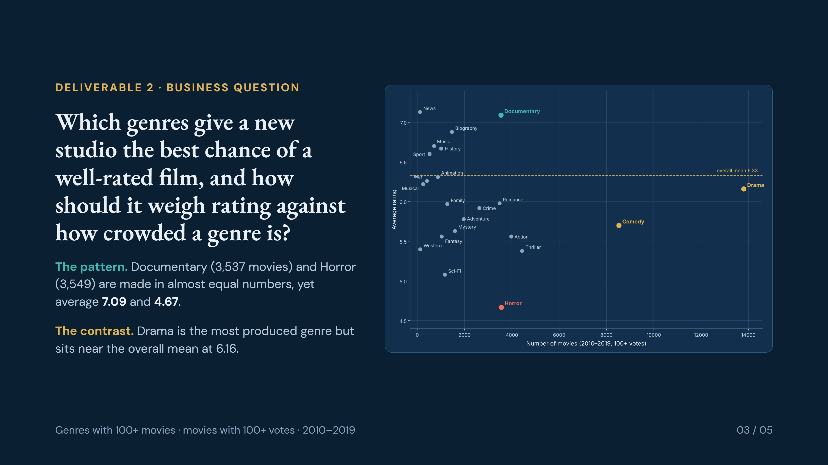
Notes:
Deliverable two. The question comes straight from the chart. Volume and quality are not related: the busiest genres, Drama and Comedy, are not the best rated, while Documentary and Horror are produced in almost identical numbers but sit 2.4 points apart. A studio choosing where to invest needs to weigh rating against how crowded a genre is.

Slide 4
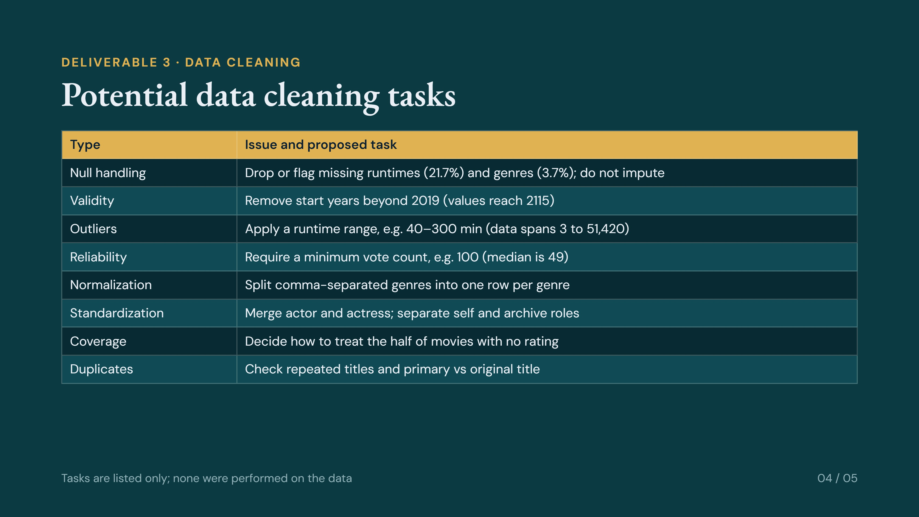
Notes:
Deliverable three. Each task comes from something we measured: null counts for runtime and genre, years running to 2115, runtimes from 3 to 51,420 minutes, a median of only 49 votes, comma-separated genres that need normalizing, and actor and actress stored as separate categories. Consistent with the assignment, these are listed but not performed.

Slide 5
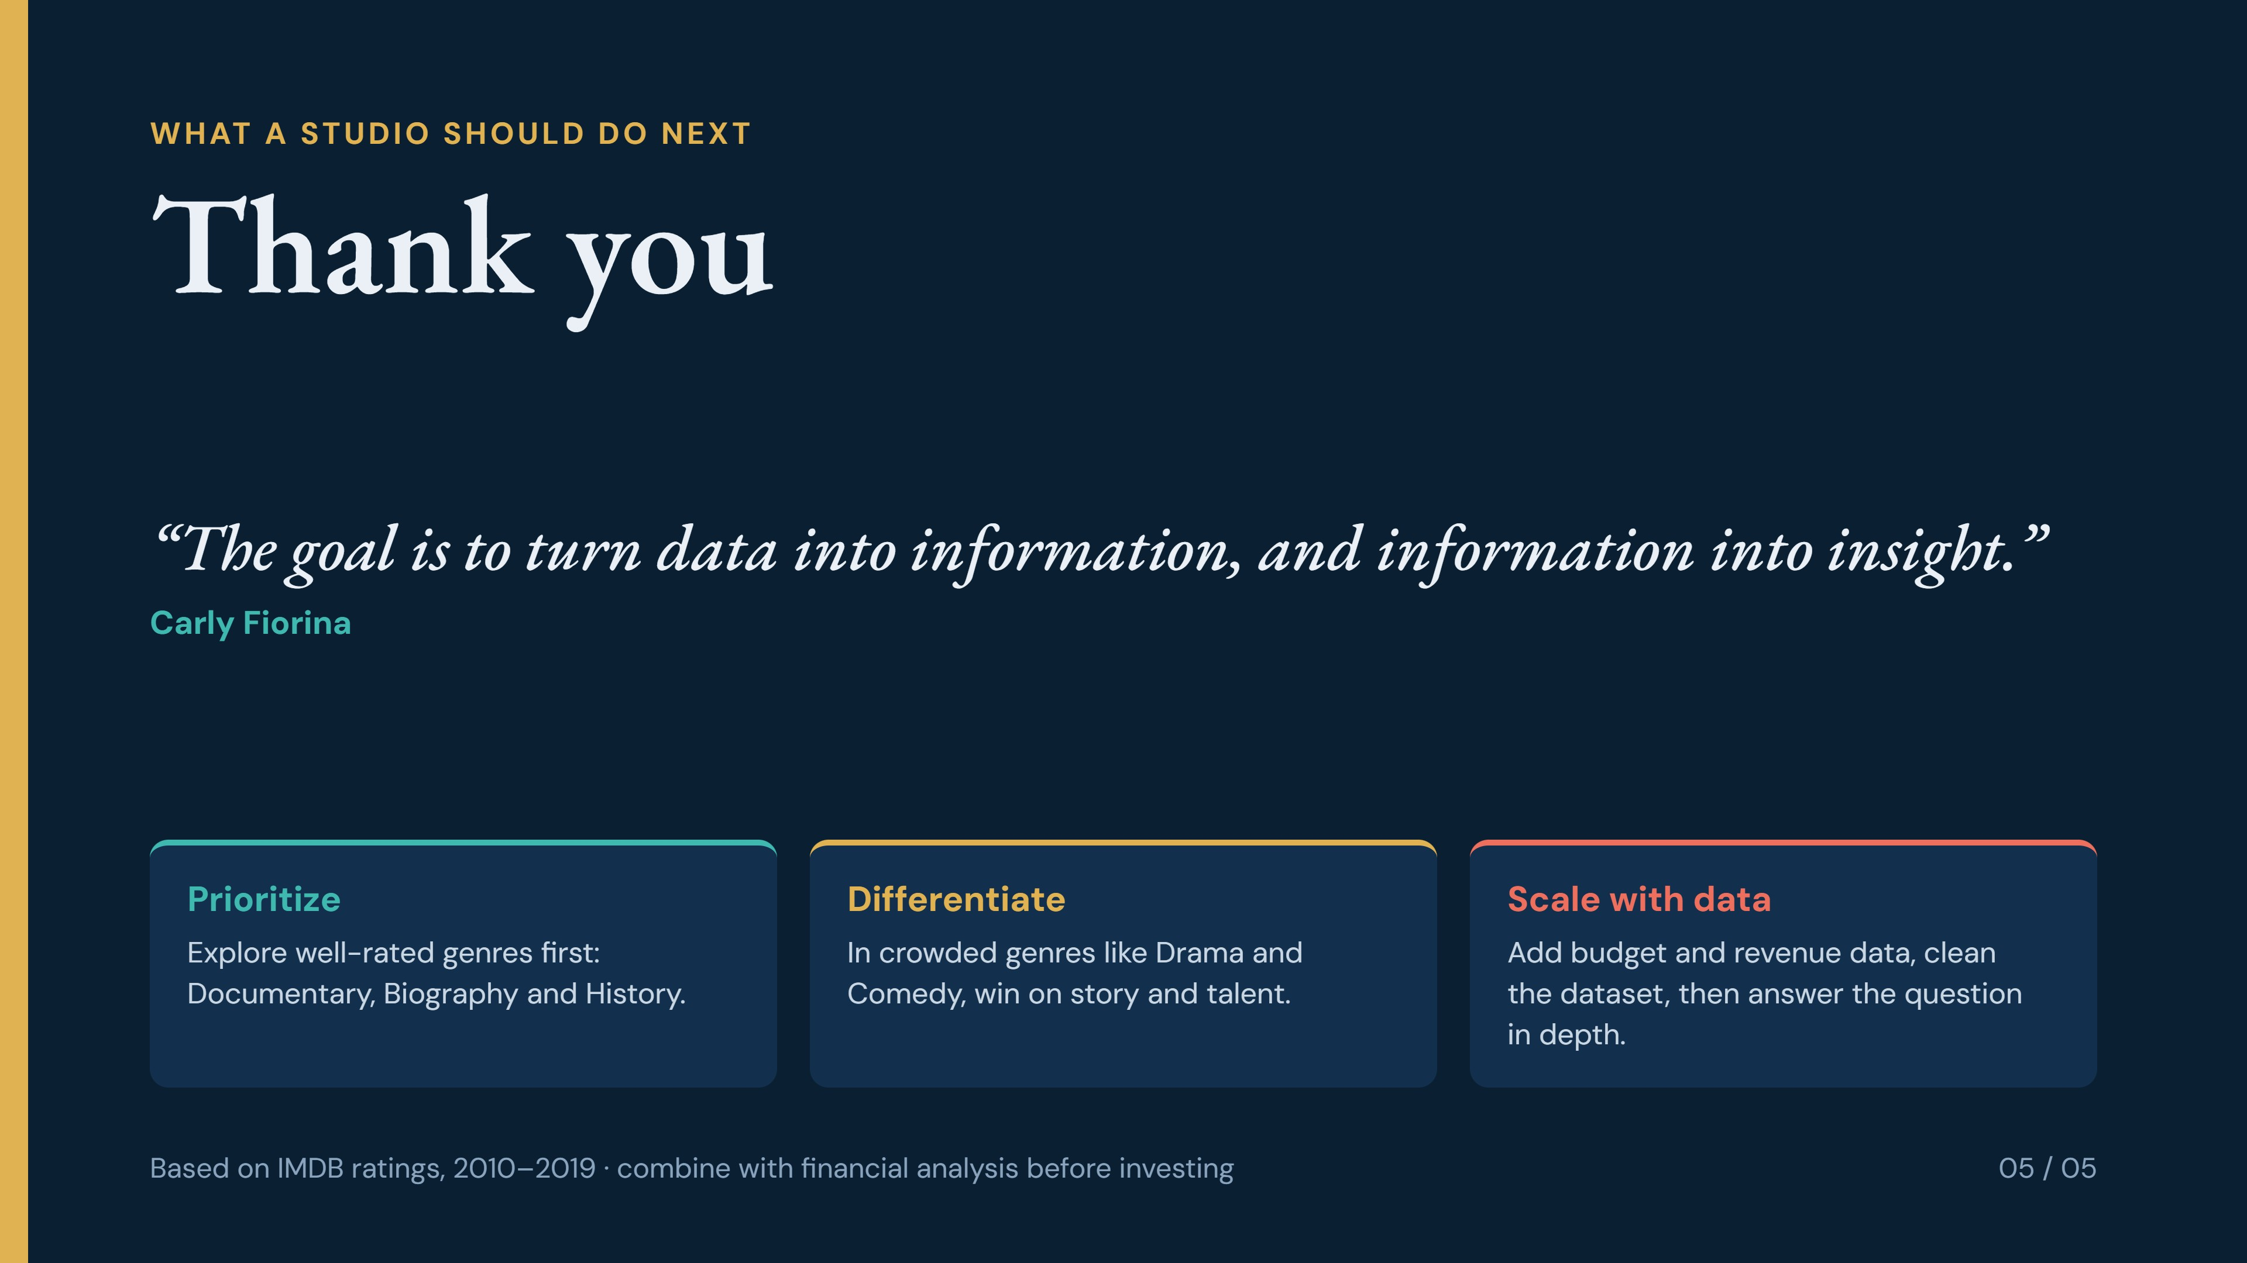
Notes:
Close by thanking the audience. The takeaway: what the industry makes most is not what audiences rate best. For a studio that wants to scale, prioritize well-rated genres, differentiate in crowded ones, and add financial data and clean the dataset before going deeper. Finish on the quote about turning data into insight, then invite questions.

